Slide 1
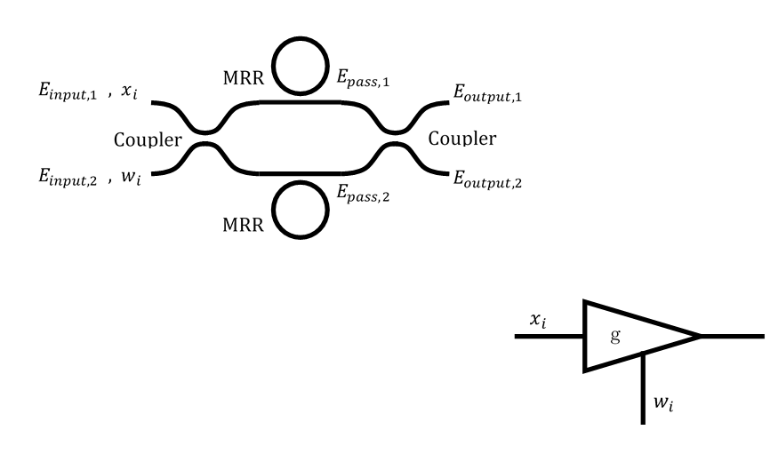
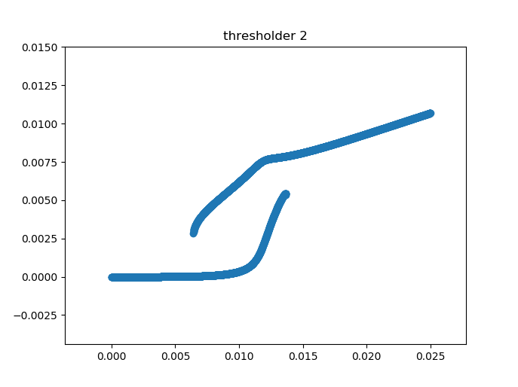
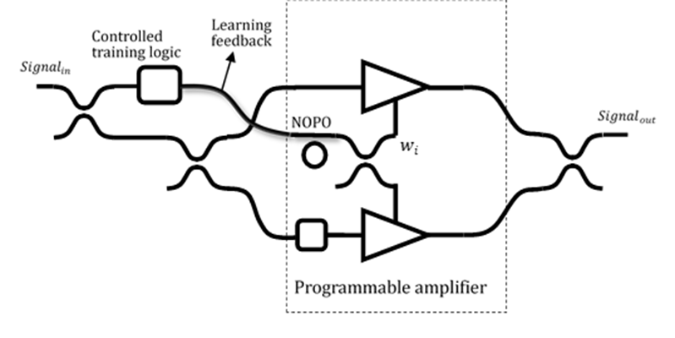
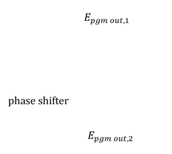
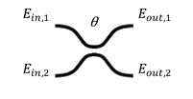
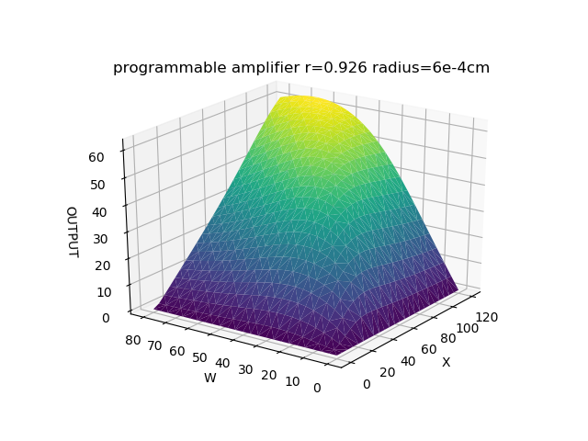
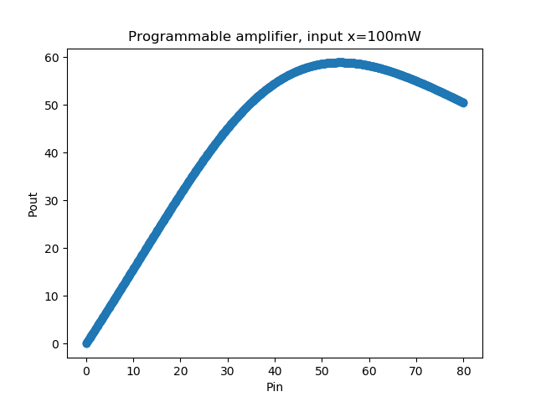
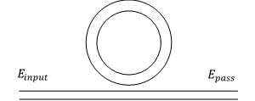
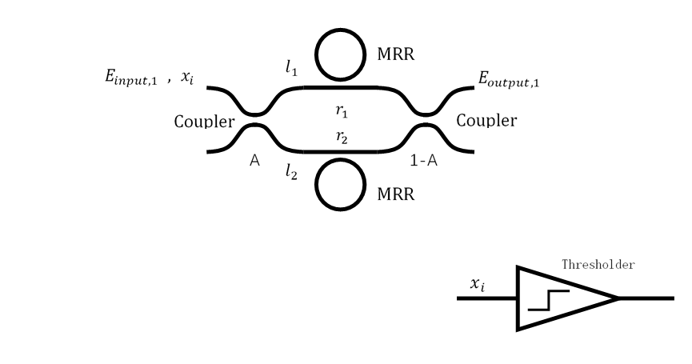
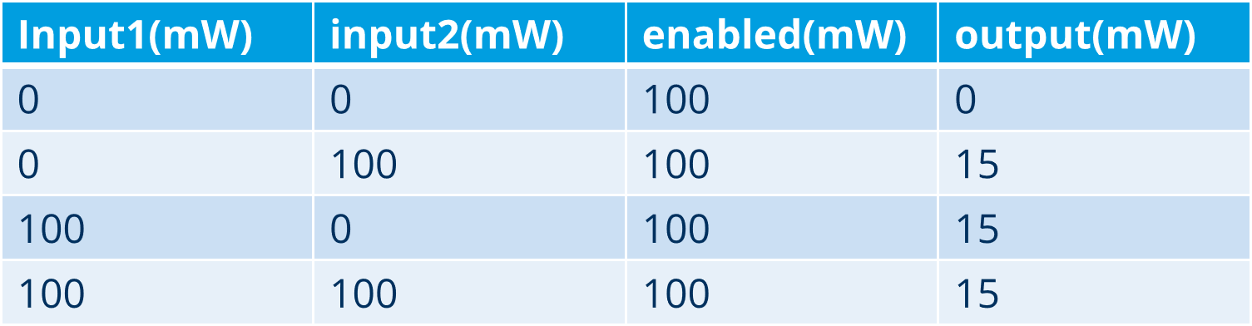
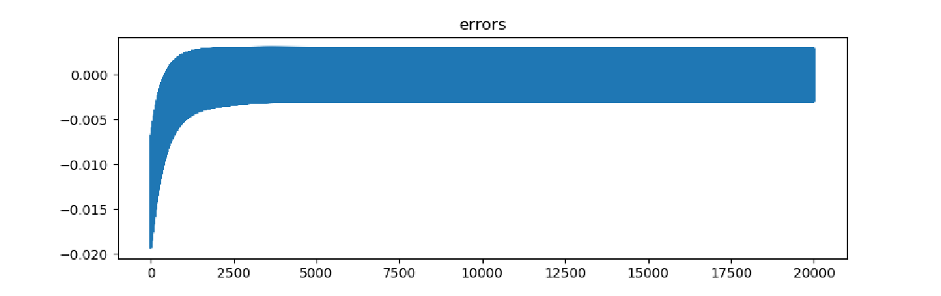
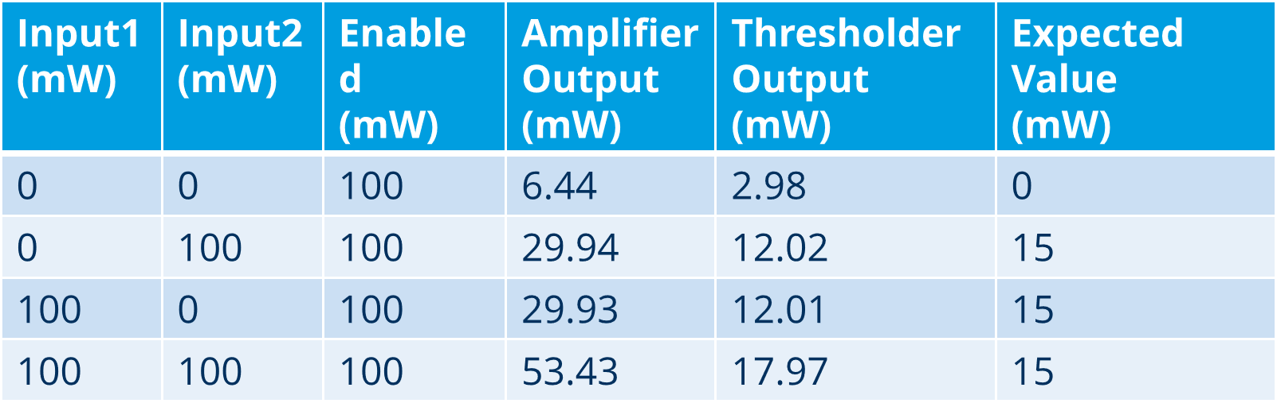
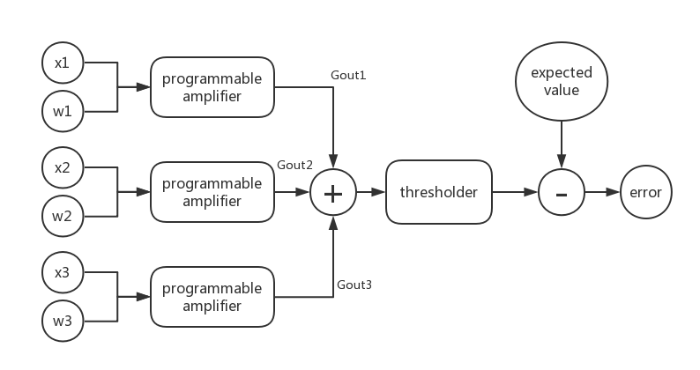
Hauptseminar
Simulation of a Perceptron Based on Optical Devices
Yunbin Shen & Ming Ke
Betreuer: M.Sc. Mircea Catuneanu
Introduction
The performance of neural networks built with optical components is not limited by electronic clock rates, ohmic losses, problems of electromagnetic compatibility (EMC), etc. They have higher speed and energy efficiency for learning tasks. Once an optical neural network(ONN) is trained, the architecture can be passive, and computation on the optical signals will be performed without additional energy input. These features could enable ONNs that are substantially more energy-efficient and faster than their electronic counterparts.
The Simulated Perceptron
In our program, the model of a perceptron is modularized and consists of some optical components.
Coupler
The coupler that is also called beam-splitter is a part of an optical amplifier circuit. The following figure demonstrates the structure of the coupler. The coupler mixes two input fields and has two output fields. The relationship between both fields are parametrized by a matrix about a mixing angle θ,
Microring Resonator
In our project all-pass ring resonators are used and their input is one output of a coupler.
Two main parameters, the circulating power buildup factor B and single pass phase shift , are needed to describe the feature of the resonator. The resonance relationship of a linear MRR with the self-coupling coefficient r and the power attenuation coefficient [1/cm] (=exp⁡(-L), L is the round tripround-trip length) can be expressed
In a cavity of MRR, the phase shift from the original of the small signal depends on BP. The resonance relationship can be expressed
From those two formulas, a cubic equation can be obtained
From this equation can we get at least one real root, sometimes three real roots. When there are three real roots, for the nonlinear resonator values of P are regions of bistability; the medial root being an unstable solution. The one or two stable solutions for (P) are substituted into
Amplifier
Programmable Amplifier
Its programmable function is realized by combining characteristics of nondegenerate optical parametric oscillators(NOPOs) and amplifiers. The signal through the NOPO adds a small vector with unchanged amplitude but different phase, so the module of output has a bias compared to the input signal. Through the following amplifier the signal with different bias has a different gain. In this way, its process is programmable.
Thresholder
It looks similar to the amplifier, but it is asymmetric.
It has bistability and only one input.
Program and Results
Structure of the Programm
This is the structure of the programm. The input data of the optical perceptron is:
[ x1, x2, x3, expected (output) ]
Then the weights w are changed by:
wi = wi + error * Gouti * η i=1,2,3
Optical Thresholder
At first is the thresholder, which is at the end of the optical perceptron. Device parameters are A = 0.483, r1 = 0.970, r2 = 0.989, ∅0 = −0.0481 and ∅b = 0.667, the refractive index n = 3.45, loss α = 2.4dB/cm, intensity-dependent refractive index n_2 = 7.5*10e-14cm2/w, and mode cross section A_eff = 1.2*10e-10cm2, the MRR radius is 4μm and excitation wavelength very near 1.5μm. And the result is visualized in figure below.
Optical Programmable Amplifier
Then is the programmable amplifier, parameters: r = 0.926, radius = 6e-4cm, other parameter is the same as the thresholder. When the input signal x is 100mW, the output is
Training Process
Training data is a OR function.
0 or 0 = 0, 0 or 1 = 1, 1 or 0 = 1, 1 or 1 = 1
Transfer into power
The error during the training is
Results
Output of the training:
w = [ 14.96mW, 14.96mW, 4.18mW ]
Conclusions
The simulated perceptron is available. It realize the OR function and its error can be smaller, if is smaller and learning times are more. The model of the perceptron is meaningful. It can be applied in analyzing and simulating future optical circuit. And the ANN can be further built based on our project.
Hauptteil
Dies ist ein Typoblindtext. An ihm kann man sehen, ob alle Buchstaben da sind und wie sie aussehen. Manchmal benutzt man Worte wie Hamburgefonts, Rafgenduks oder Handgloves, um Schriften zu testen. Manchmal Sätze, die alle Buchstaben des Alphabets enthalten - man nennt diese Sätze »Pangrams«. Sehr bekannt ist dieser: The quick brown fox jumps over the lazy old dog.
Unterüberschrift Ebene 2
Oft werden in Typoblindtexte auch fremdsprachige Satzteile eingebaut (AVAIL® and Wefox™ are testing aussi la Kerning), um die Wirkung in anderen Sprachen zu testen. In Lateinisch sieht zum Beispiel fast jede Schrift gut aus. Quod erat demonstrandum. Seit 1975 fehlen in den meisten

